Slide 1
Knowledge Series :
GNU/Linux & FOSS-Free Open Source Software
Presented by :
Pavan More ,
Pionium Consultants Pvt Ltd
ERP Solutions,
BNI Achievers

Slide 2
Why did i select this topic today !!??
To encourage collaborations between our members for various projects. There is proper structured, organized and accountable way to achieve this via FOSS

Slide 3


Richard Stallman
Linus Torvalds
let's hear it from the horse's mouth

Slide 4
FOSS - FREE & OPEN SOURCE SOFTWARE
Free: Not just "free of cost" (though it often is), but freedom — you can use, study, modify, and share the software.
Open Source: The source code is openly available, so anyone can inspect how it works, improve it, or fix bugs.
In short, FOSS = Freedom + Transparency + Community Collaboration.
Examples of famous FOSS projects:
- GNU/Linux (Operating System) - Firefox (Web Browser) - LibreOffice (Office Suite) - WordPress (Website CMS)

Slide 5
Usage rights / protocols
GPL/2 (General Public License) | You can modify and distribute, but you must keep it open-source too. (Copyleft)
MIT License | Very permissive — you can do almost anything, even make it closed source if you want.
Apache License | Like MIT, but also protects against patent lawsuits.
BSD License | Very free; allows using the code in proprietary software too.

Slide 6
How to contribute
Step | What You Do | Example
1. Pick a Project | Find a project that you like or use. | Linux, Firefox, WordPress, VLC, GIMP, etc.
2. Understand the Project | Read its README, CONTRIBUTING.md, and issues (on GitHub, GitLab, etc.). | Understand how they expect contributions.
3. Set up Environment | Install the project on your machine. Try to build/run it yourself. | Clone from Git, install dependencies, run locally.
4. Start Small | Fix typos, improve documentation, solve small bugs first. | Check issues tagged "good first issue".
5. Discuss Before Big Changes | Open an "issue" to discuss big ideas before coding. | Communicate with maintainers.
6. Fork → Commit → Pull Request | Fork the repo, make changes, push, and open a Pull Request (PR). | "Hey, I fixed bug #123!"
7. Be Patient & Open to Feedback | Maintainers might suggest improvements. | Review, fix, resubmit if needed.

Slide 7
How to make open source projects & community initiatives
It’s simple .
Just make it , add usage/license terms , host on Github or SVN hosting.
Maintain the libraries / code .
Motivate people to contribute.
OR
Buy a Coffee or Beer for the developer for their encouragement(Donate).
We are Simple folks .

Slide 8
Well known software/solution solution/library in Linux

Slide 9
Category | Name | Description
Operating System | Ubuntu, Fedora, Debian, CentOS, Arch Linux | Popular Linux distributions (distros) used on servers, desktops, and cloud.
Desktop Environments | GNOME, KDE Plasma, XFCE, LXDE | Graphical interfaces (like Windows UI) for Linux.
Web Servers | Apache, Nginx | Powers most of the world's websites!
Database Servers | MySQL, MariaDB, PostgreSQL, MongoDB | Famous open-source database engines.
Programming Languages | Python, C, C++, Bash, Perl, Go, Rust | Heavily used in Linux environments.
Development Tools | GCC, Make, CMake, Git, GDB | Essential compilers, build systems, debuggers, and version control.
Containers / Virtualization | Docker, Podman, LXC, KVM | Tools to run containers and virtual machines.
Security Tools | SELinux, AppArmor, iptables, OpenSSL | Protect Linux systems and networks.
Networking Tools | OpenVPN, WireGuard, SSH, Samba | Secure communication and file sharing.

Slide 10
Category | Name | Description
Package Managers | apt (Debian/Ubuntu), yum/dnf (RHEL/Fedora), pacman (Arch) | Software installation and management tools.
Cloud Tools | Kubernetes, Ansible, Terraform | Open source tools for cloud orchestration and automation.
File Systems | ext4, Btrfs, XFS, ZFS | How data is organized and stored in Linux.
Office/Productivity | LibreOffice, OnlyOffice | Open-source replacements for MS Office.
Graphics and Design | GIMP, Inkscape, Blender | Open-source Photoshop/Illustrator/3D animation alternatives.
Multimedia | VLC, FFmpeg, Audacity | Media players and editors.
Libraries | glibc (GNU C Library), OpenSSL, GTK, Qt | Core libraries powering Linux apps and security.

Slide 11
It’s not just software there’s FOSS Hardware as well
Well-known open-source hardware projects

Slide 12
Project | Description | Impact
Arduino | Open-source microcontroller boards and software (for DIY electronics, robotics, IoT). | Sparked the DIY/Maker revolution. Arduino SA became a global company.
Raspberry Pi | Low-cost, credit-card-sized computer for education and prototyping. | Raspberry Pi Foundation's products sold 60M+ units.
Prusa 3D Printers | Open-source 3D printers based on RepRap project. | Josef Prusa's company (Prusa Research) is a multi-million dollar 3D printing leader.
FarmBot | Open-source CNC farming machines. | Farming automation and education innovation.
OpenROV / OpenExplorer | Underwater open-source robots for exploration. | Led to National Geographic’s support and new tech ventures.

Slide 13
GNU/Linux Usage Statistics
Area | Statistic | Notes
Web Servers | 🌐 Over 96% of the top 1 million web servers run Linux | (Source: W3Techs, Netcraft)
Cloud Platforms | ☁️ 90%+ of public cloud workloads run on Linux | (AWS, Google Cloud, Azure all use Linux heavily)
Mobile | 📱 85% of smartphones run Linux (via Android) | Android is Linux-based!
Supercomputers | 💻 100% of the world's top 500 supercomputers run Linux | (TOP500 list - 2024)
Desktop PCs | 🖥️ About 3%-4% of desktops/laptops run Linux | But steadily increasing with gaming (Steam Deck, Proton).

Slide 14

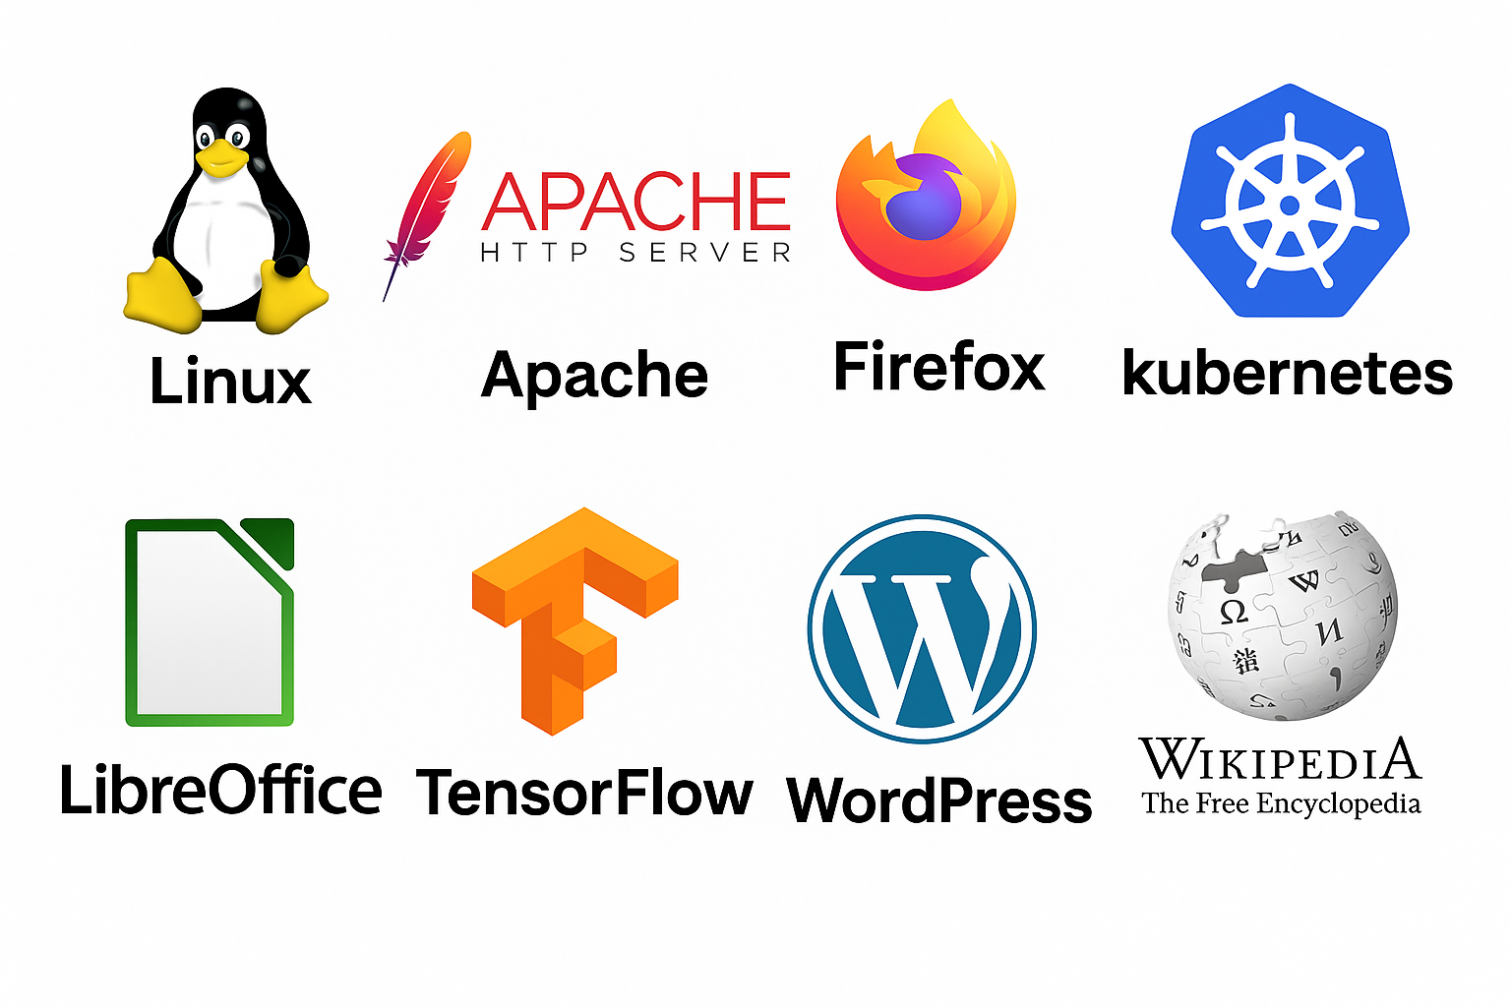

Well known brands/ logos/ mascots

Slide 15
Ways to Earn Money from Free and Open Source Software (FOSS)

Slide 16
Strategy | How It Works | Example
Paid Support & Services | Offer installation, customization, troubleshooting, training. | Red Hat charges for Linux support.
Freemium Model | Basic version free, advanced features paid (dual licensing). | GitLab, ElasticSearch (Elastic)
Consulting & Custom Development | Build custom solutions based on FOSS for companies. | Freelancers setting up WordPress, Odoo, or Kubernetes.
Hosting and SaaS | Host FOSS software and charge for convenience. | WordPress.com hosts free WordPress and sells hosting plans.
Certification and Training | Create paid courses, workshops, certifications around FOSS technologies. | Linux Foundation certifications.
Donation and Crowdfunding | Ask community donations via Patreon, GitHub Sponsors, OpenCollective, etc. | Many small FOSS tools survive this way.

Slide 17
Strategy | How It Works | Example
Dual Licensing | Offer your software under both a free license and a paid commercial license. | MySQL did this successfully.
Enterprise Editions | Offer a free community edition + paid enterprise edition with premium features. | Odoo Community vs Odoo Enterprise.
Merchandising | Sell branded T-shirts, mugs, stickers, etc. | Mozilla and Blender have merchandise stores.
Grants & Sponsorships | Tech foundations, NGOs, and companies fund critical FOSS development. | Open Collective, GitHub Sponsors.

Slide 18
How FOSS Developers / Contributors Get Paid When the Project Goes Commercial or Proprietary

Slide 19
Situation | How Developers/Contributors Earn Money | Examples
1. Company Sponsorship / Employment | The company that commercializes the FOSS project hires core contributors as employees. They get a salary. | Red Hat pays Linux developers. GitLab pays contributors.
2. Bounties / Paid Features | Developers get paid per feature, bug fix, or task under bounty programs. | Mozilla, Gitcoin, and many others run bounties.
3. Revenue Sharing / Profit Sharing | If a company makes revenue (e.g., SaaS), some projects share profits with key contributors. | This is rare but growing with platforms like Open Collective.
4. Donations and Crowdfunding | Before/after commercialization, contributors may receive donations from the community or from platforms like GitHub Sponsors, OpenCollective, or Patreon. | Blender, Homebrew, Mastodon developers get funded this way.

Slide 20
Situation | How Developers/Contributors Earn Money | Examples
5. Consulting & Support Services | Core developers offer consulting, setup, support, customization services after commercialization. | Odoo partners, WordPress experts.
6. Dual Licensing Deals | If a company dual-licenses a project (GPL + commercial license), contributors may get a share if there’s an agreement. | MySQL developers before Oracle bought it.
7. Grant Funding | Some get research grants, NGO support, or foundation sponsorships to continue improving the project. | Linux Foundation, Mozilla Foundation fund projects.
8. Equity/Stock Options | In some startups, core contributors get company stock when the project is monetized. | GitLab early contributors received equity when it IPO'd.
9. Early Buyout or Acquisition | Companies may buy the project or company, and contributors get a one-time payout. | Elastic, MongoDB teams benefitted during acquisitions/expansions.

Slide 21
A Unique Opportunity For All of us via FOSS / Community Initiatives.
Each one of you sitting here today has old projects, ideas, or code —the seeds of something powerful.
Maybe even a billion-dollar idea, waiting to be reborn.
But individually, we are often limited by resources, time, or the right talent.And sometimes, our own hesitation holds us back.
What if we came together?
What if we collaborated under a Free and Open Source (FOSS) initiative, where your idea is not forgotten —but instead becomes a living, growing project powered by all of us?
No heavy investments needed.
No ego battles — only recognition, contribution, and growth.

Slide 22
Q & A

